Slide 1
Applications for visualization of the relationship between serum vitamin D and colorectal cancer incidence
Presented by: Grace Wilson

Slide 2
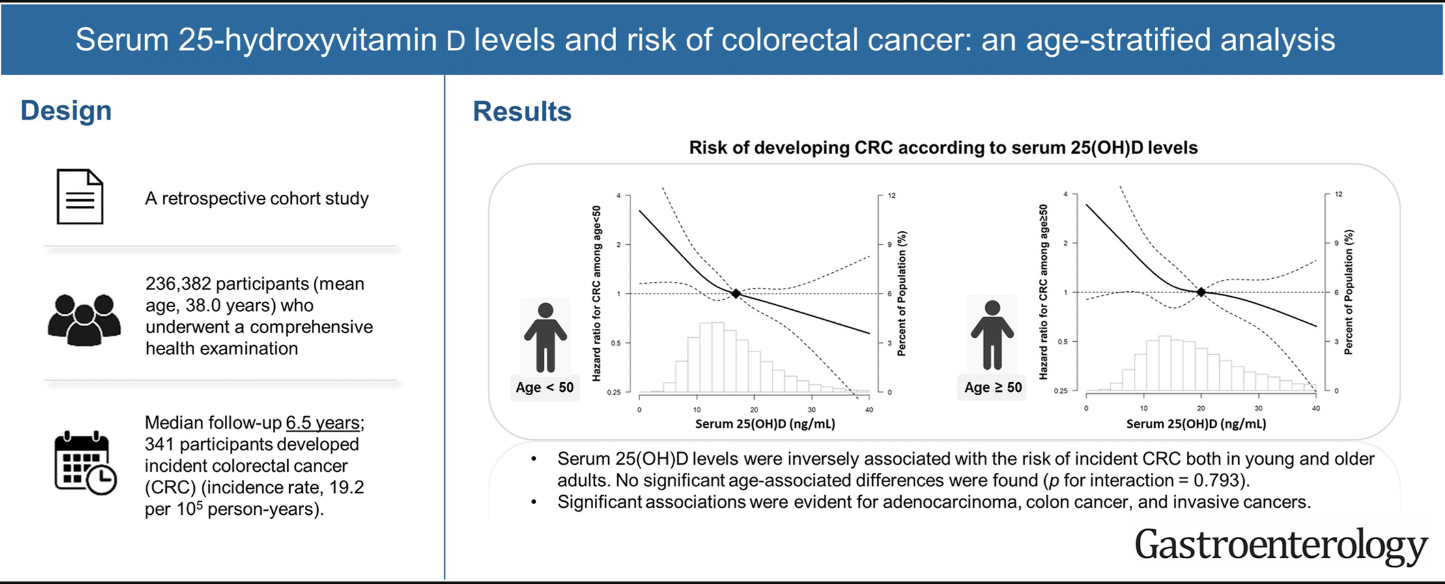
(Kim Gastroenterology 2023)

Slide 3
Data collection (creation)
Metastatic colorectal cancer
“The median plasma 25(OH)D level in the entire cohort was 20.0 ng/mL (range, 2.3 to 75.4 ng/mL) and the mean was 21.0 ng/mL (SE of mean, 0.4 ng/mL).”
listed types of colon cancer and ranges similar to these, with similar averages.
(Ng JCO 2011)
Notes:
Vitamin D Status in Patients With Stage IV Colorectal Cancer: Findings From Intergroup Trial N9741
https://doi.org/10.1200/JCO.2010.31.7255

Slide 4
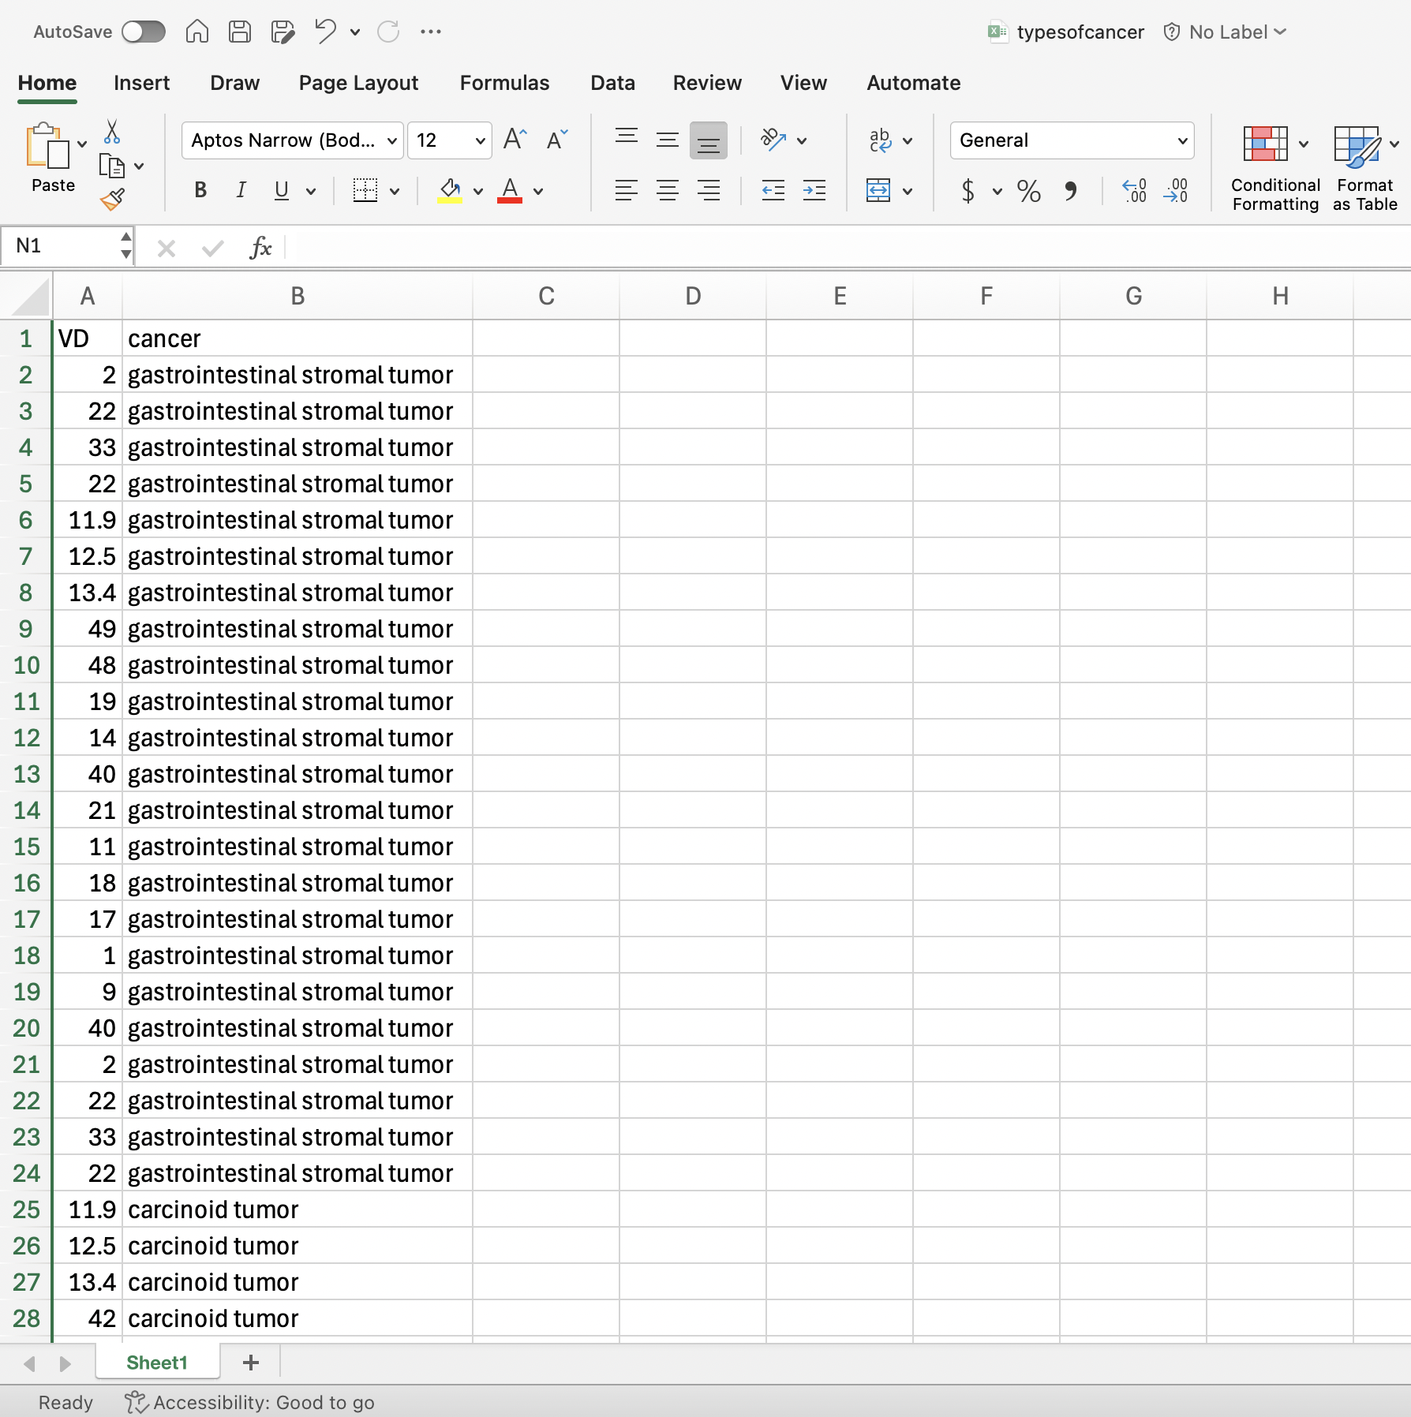
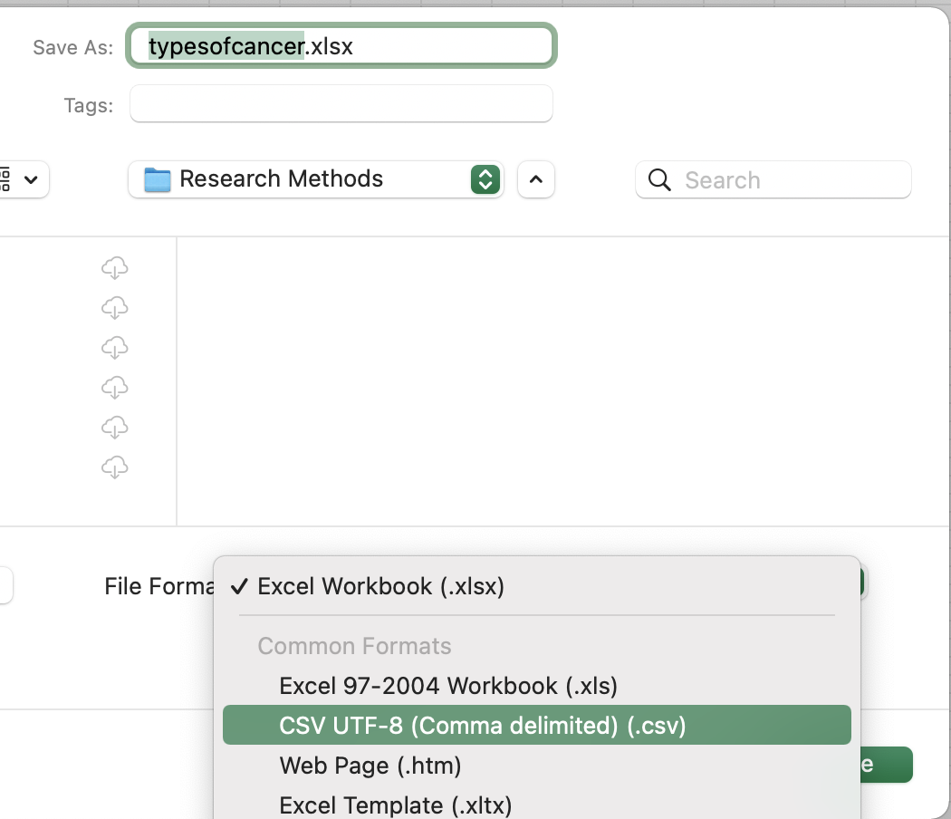
Data collection (creation)

Slide 5
Research questions
How do serum levels of vitamin D(25-hydroxyvitamin D) vary across types of colorectal cancer?
Is there a trend of deficiency?
What is the distribution of vitamin D levels within cancer types?

Slide 6
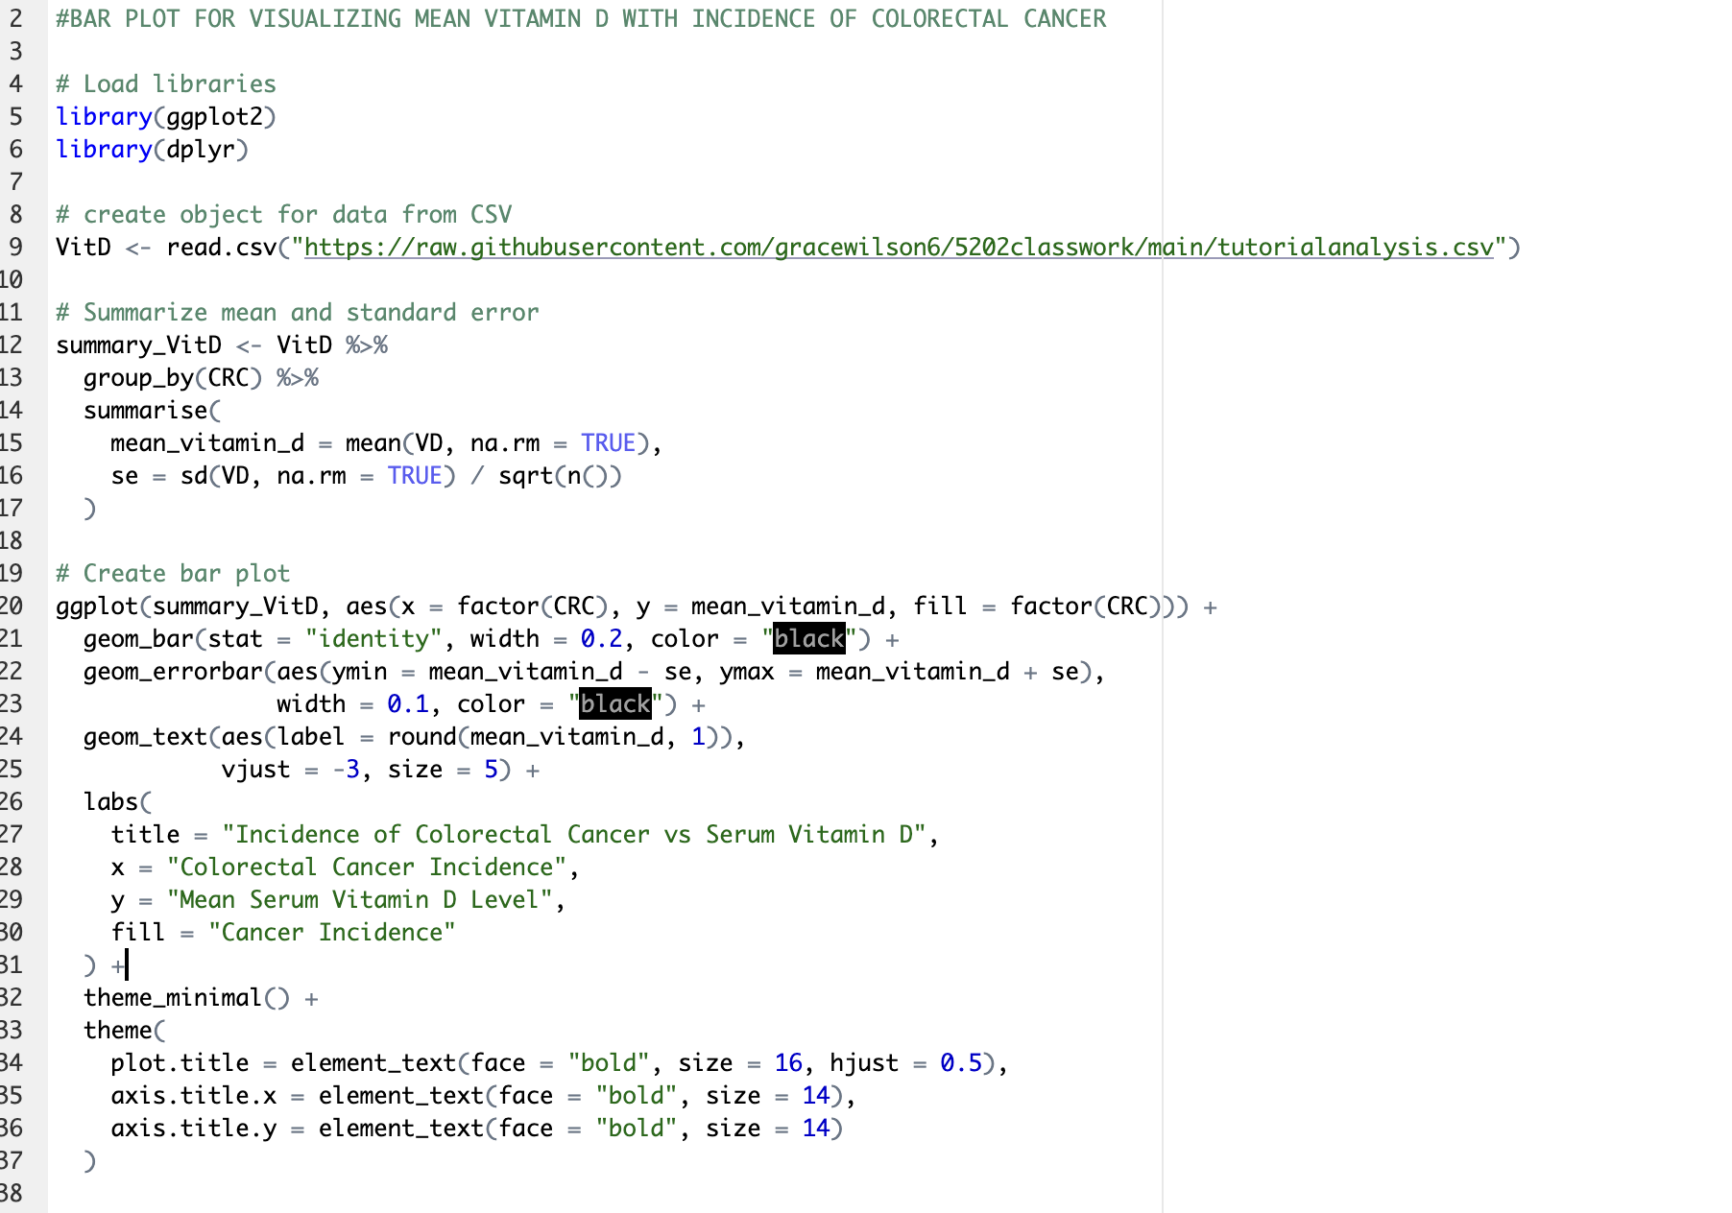

Slide 7
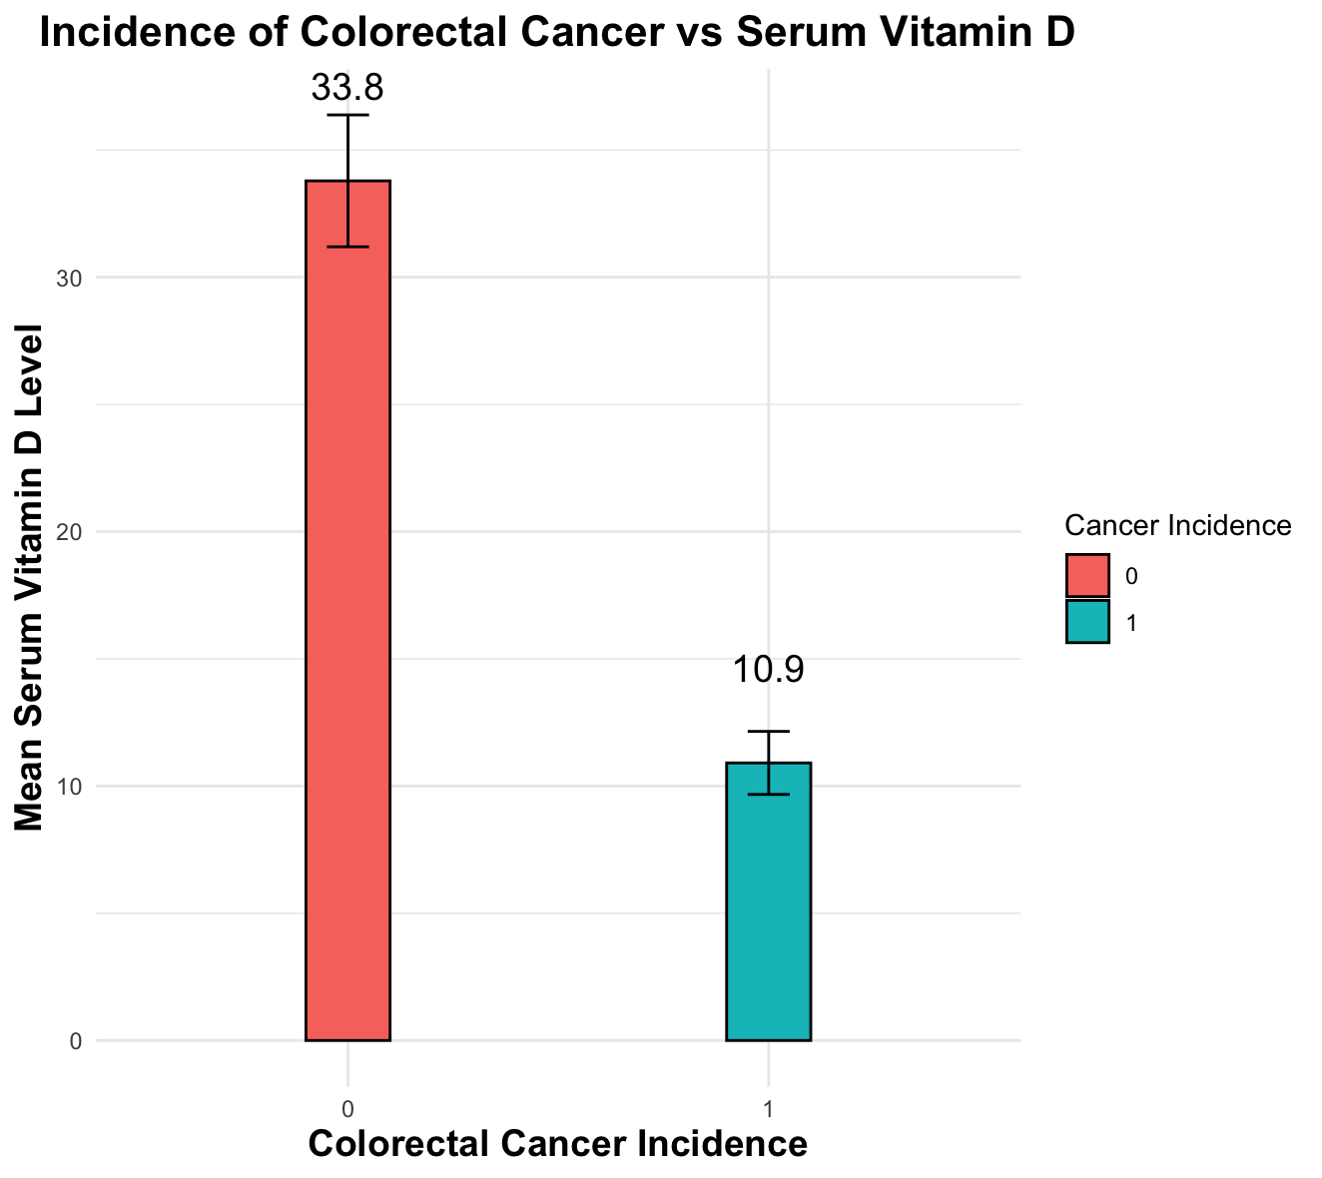

Slide 8
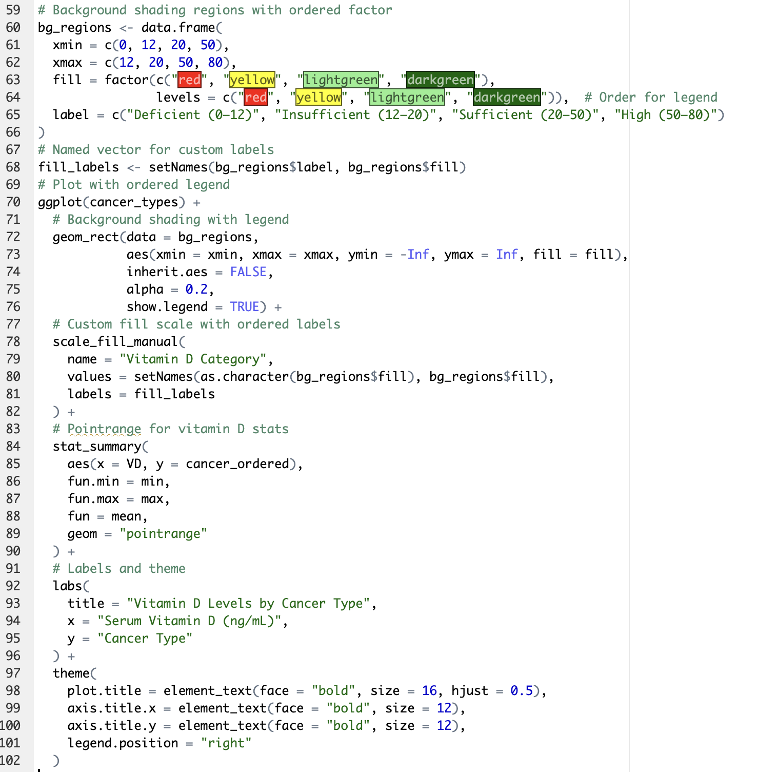

Slide 9
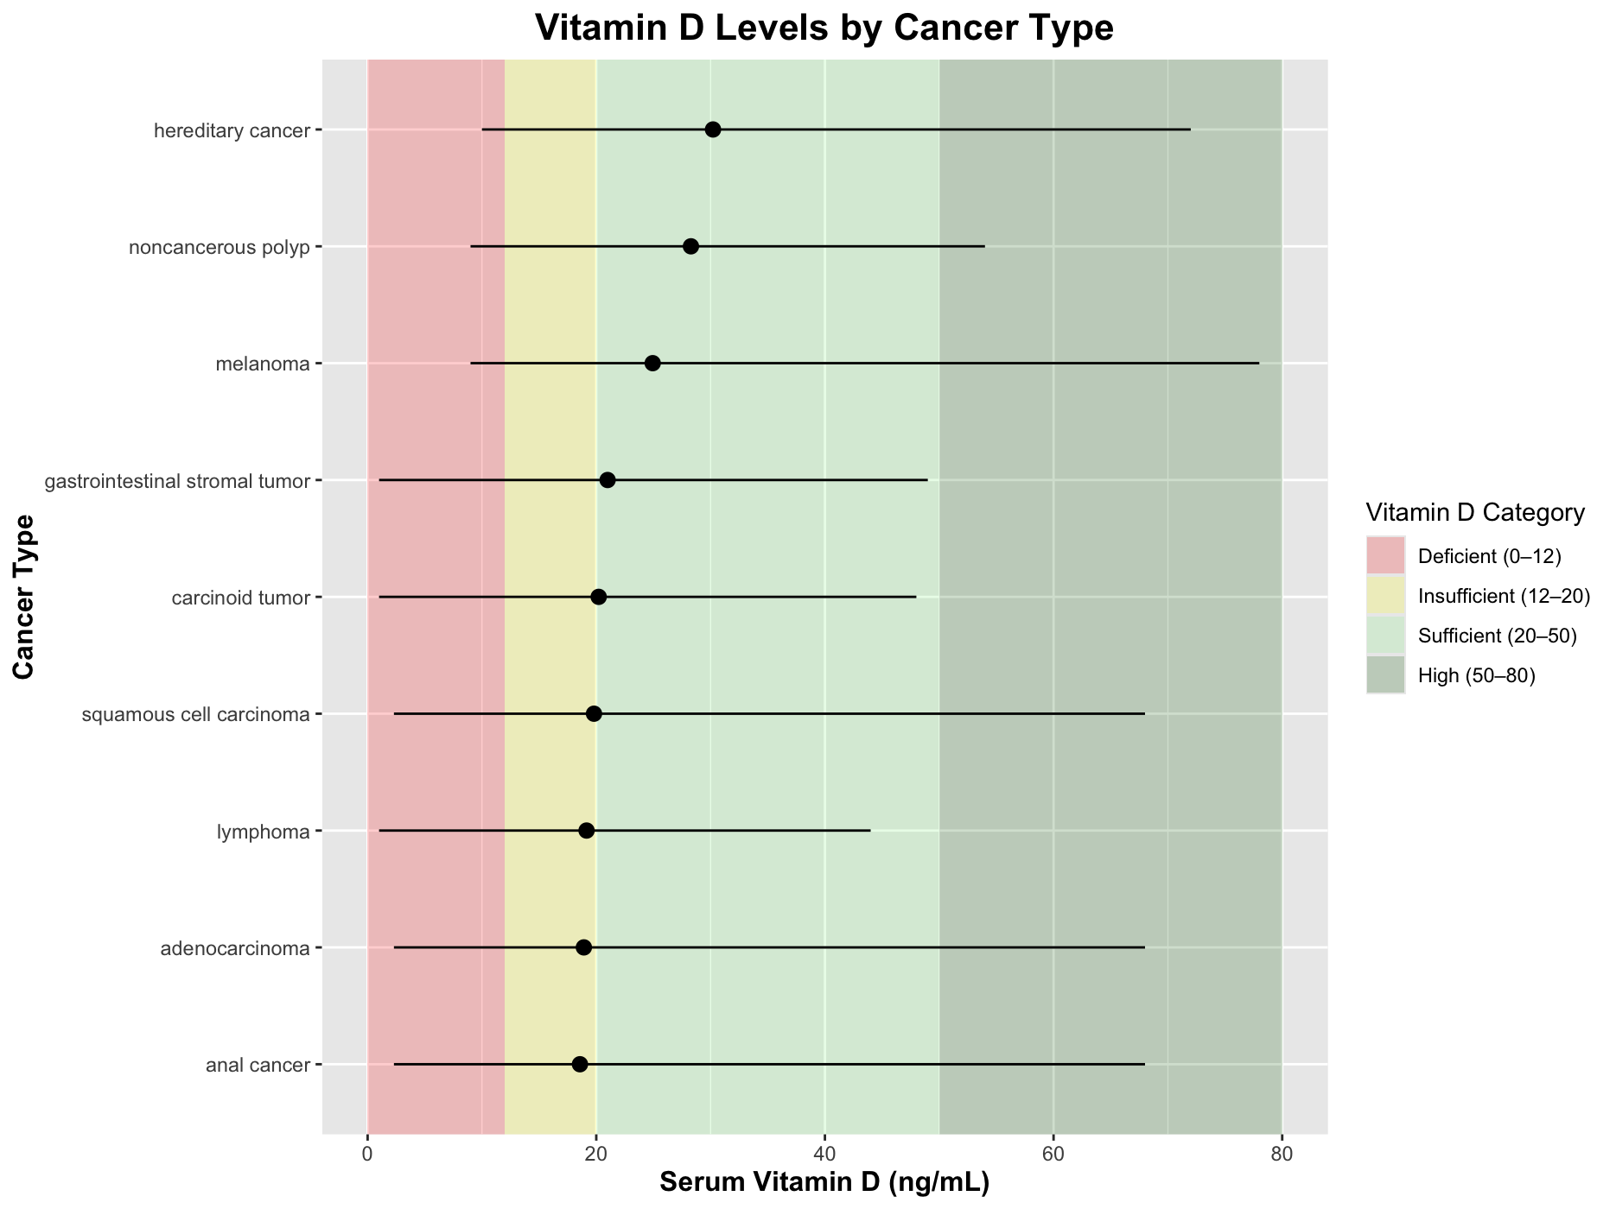

Slide 10
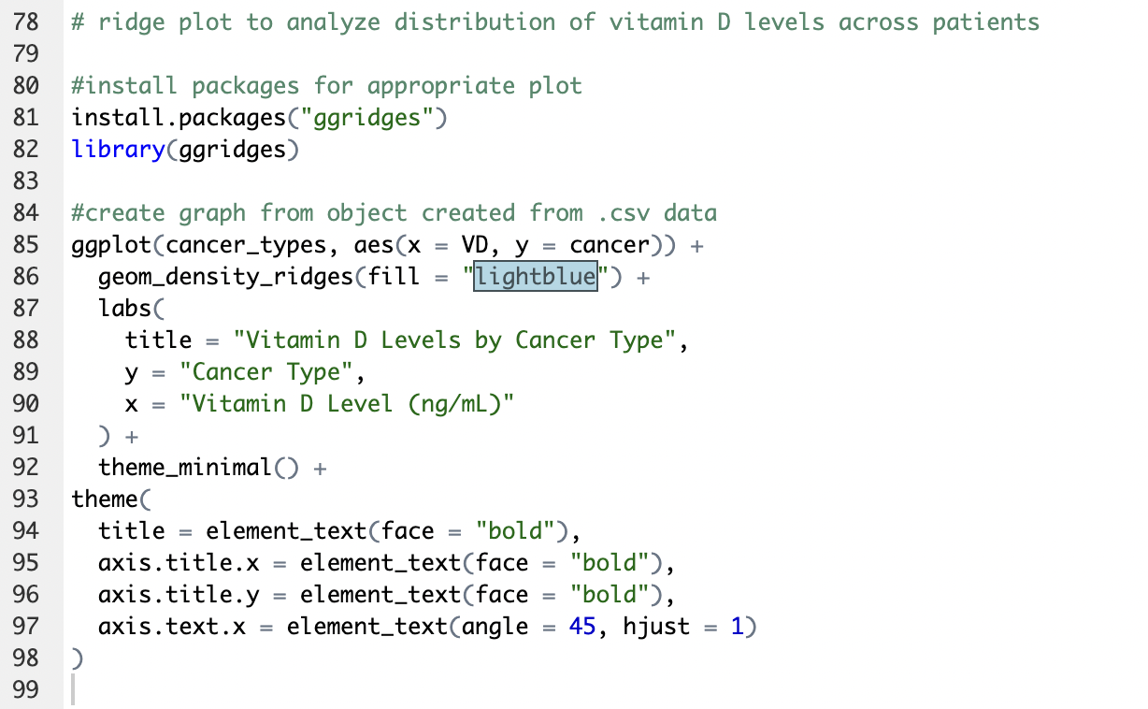

Slide 11
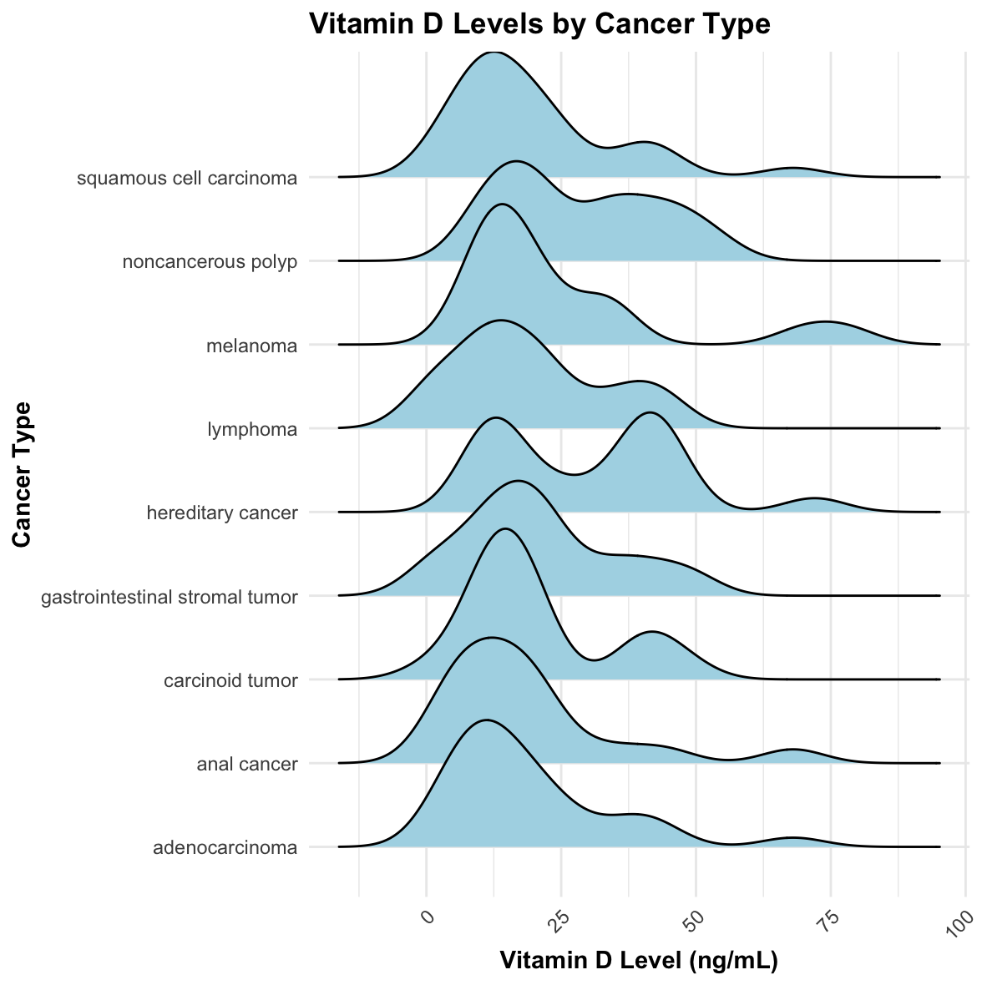

Slide 12
Research questions
How do serum levels of vitamin D(25-hydroxyvitamin D) vary across types of colorectal cancer?
Is there a trend of deficiency?
What is the distribution of vitamin D levels within cancer types?

Slide 13
Na,Soo-Youngetal.2022.VitaminDandColorectalCancer:Current Perspectives and Future Directions. Journal of Cancer Prevention. 27(3), 147- 156. https://doi.org/10.15430/JCP.2022.27.3.147
Ng K, Sargent DJ, Goldberg RM, Meyerhardt JA, Green EM, Pitot HC, Hollis BW, Pollak MN, Fuchs CS. Vitamin D status in patients with stage IV colorectal cancer: findings from Intergroup trial N9741. J Clin Oncol. 2011 Apr 20;29(12):1599-606. doi: 10.1200/JCO.2010.31.7255. Epub 2011 Mar 21. PMID: 21422438; PMCID: PMC3082978.
Kim,Yejinetal.Serum25-HydroxyvitaminDLevelsandRiskofColorectal Cancer: An Age-Stratified Analysis. Gastroenterology. 165(5), 920- 931. 10.1053/j.gastro.2023.06.029

